Slide 1
Climate Change Social Media Sentiment Analysis
Machine Learning & Dashboard Visualization Project
Tools: Python (Pandas, Scikit-learn), Power BI, DAX
Blesson Biju
UMID – UMID27112571779
Dec 1st Batch

Slide 2
Problem Statement
Climate change discussions are increasing on social media. Understanding public sentiment is important to:
Measure public awareness
Analyze engagement patterns
Identify opinion trends
Support data-driven climate communication strategies
Objective: To analyze and classify social media posts related to climate change using Machine Learning.

Slide 3
Dataset Overview
Features:
date
text
text_length
likesCount
commentsCount
sentiment_score
sentiment
Total Records: 504
The dataset contains social media posts discussing climate change along with engagement metrics and sentiment labels.

Slide 4
Data Preprocessing
Removed missing values
Converted date column to datetime
Cleaned text (lowercase, removed special characters)
Generated text_length feature
Tokenization & vectorization
Train-test split

Slide 5
Sentiment Analysis Model
Steps:
Text vectorization (TF-IDF)
Model training
Model evaluation
Evaluation Metrics:
Accuracy
Precision
Recall
F1-score

Slide 6
Model Results
Accuracy score
Confusion Matrix
Classification Report summary
The model successfully classified climate-related posts into Positive,
Neutral, and Negative categories with good accuracy, demonstrating
effective sentiment detection.

Slide 7
Key Observations from ML
Majority of posts fall under ______ sentiment
Engagement varies across sentiment categories
Some sentiment classes receive higher likes and comments

Slide 8
Power BI Dashboard
Dashboard Includes:
Total Posts
Total Likes
Total Comments
Average Sentiment Score
Sentiment Distribution
Engagement by Sentiment
Sentiment Trend Over Time
Text Length vs Sentiment Score

Slide 9
Dashboard Insights
Positive sentiment dominates discussions
Negative posts receive higher engagement
Sentiment fluctuates slightly over time
Longer posts tend to show stronger emotional polarity

Slide 10
Conclusion
Successfully built an end-to-end ML pipeline
Performed sentiment classification
Visualized results using Power BI
Identified engagement patterns in climate discussions

Slide 11
Tools & Technologies
Python (Pandas, NumPy, Scikit-learn)
Power BI & DAX
CSV-based analytics dataset
Jupyter Notebook

Slide 12
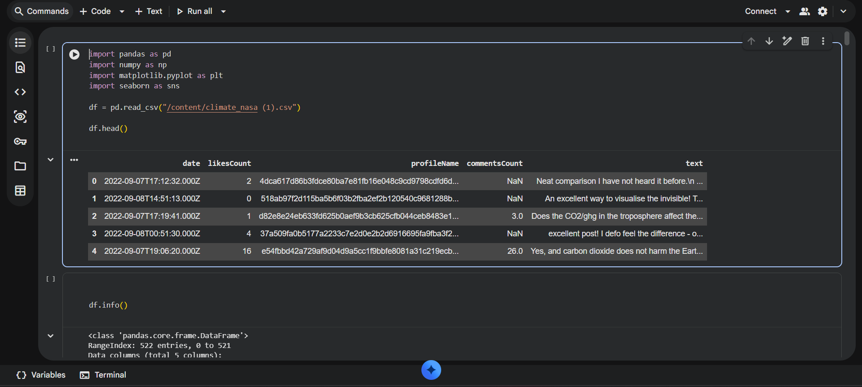

Slide 13
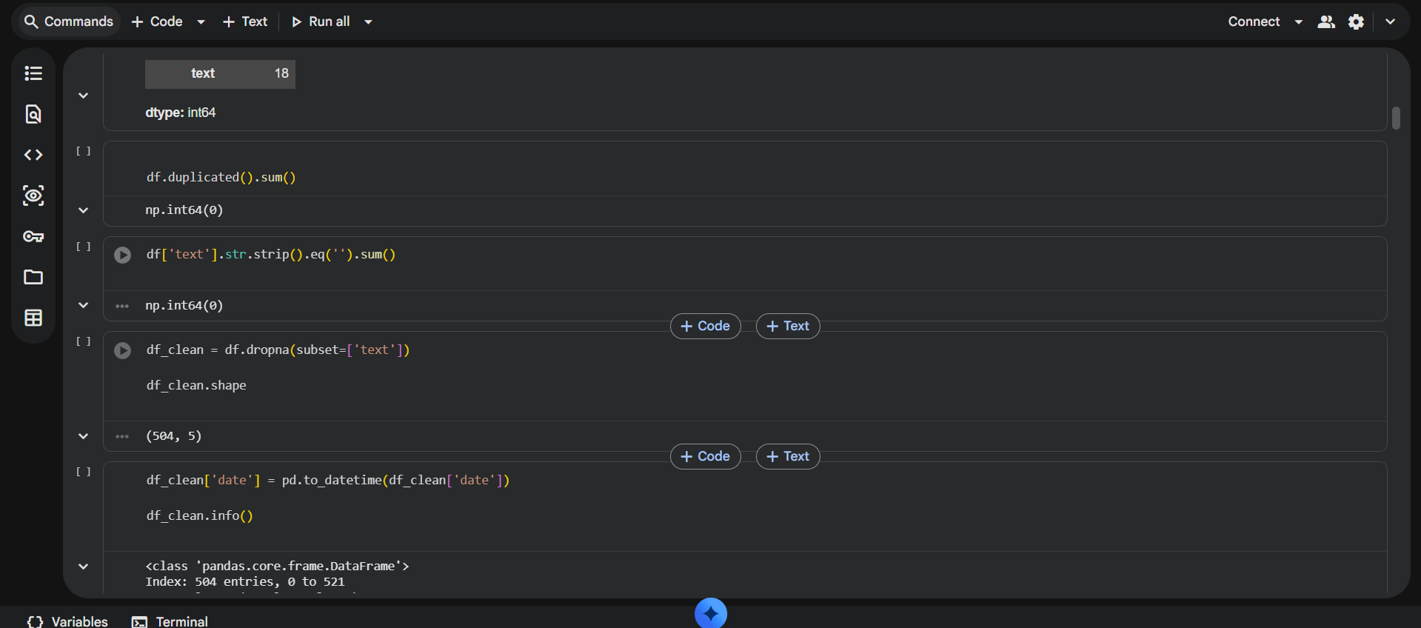

Slide 14
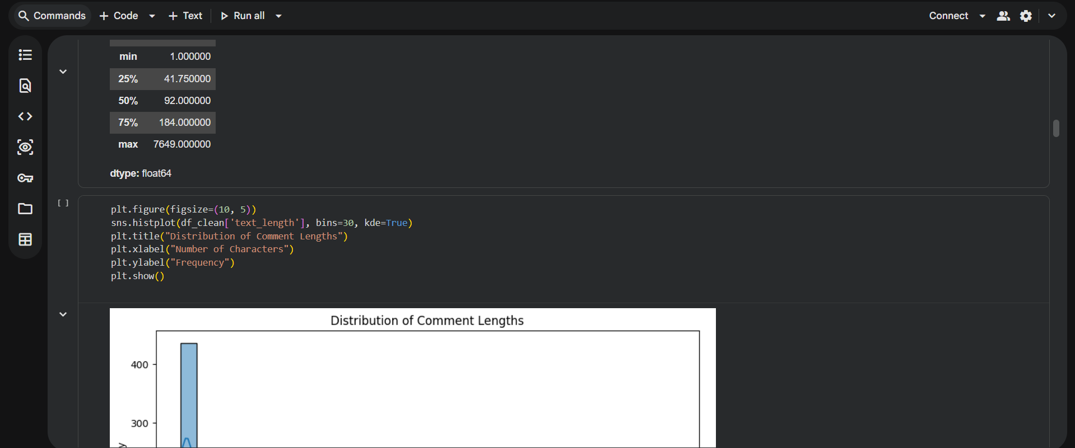
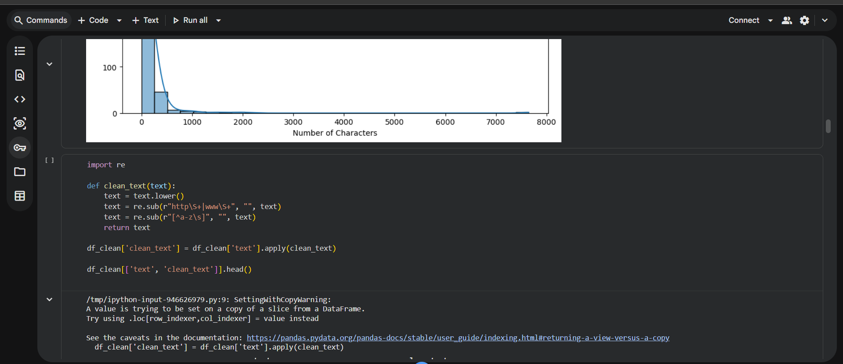

Slide 15
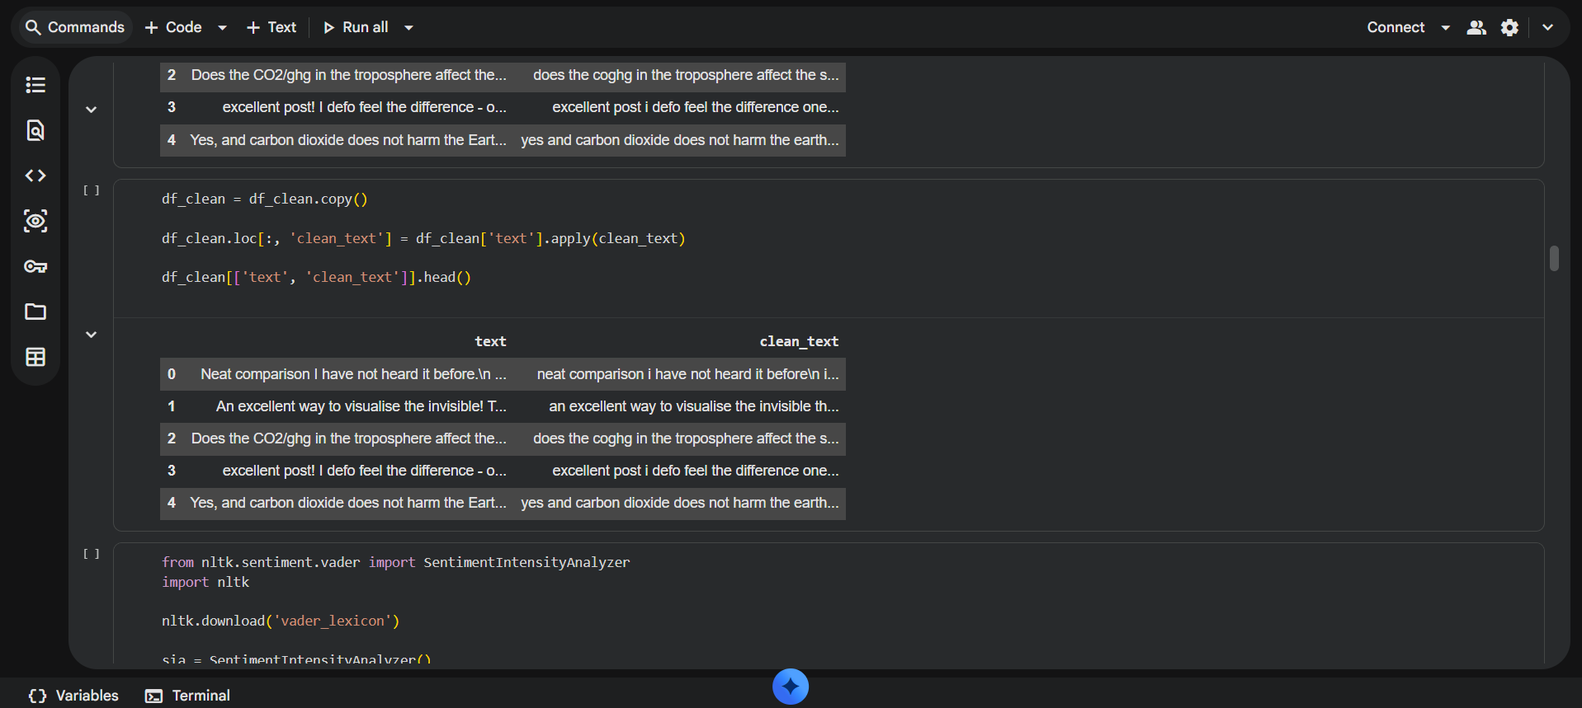

Slide 16
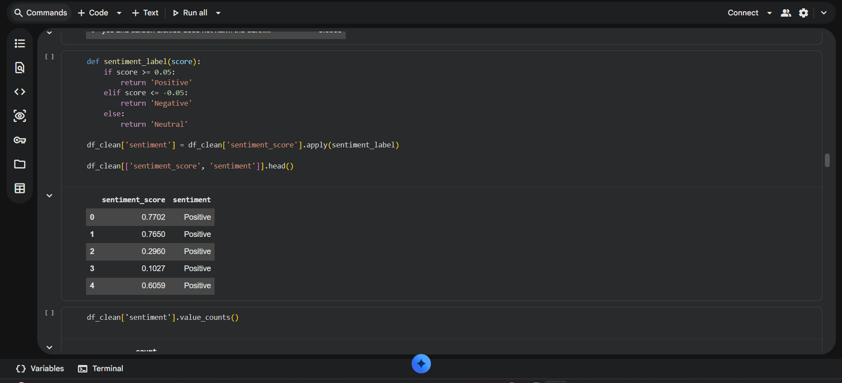
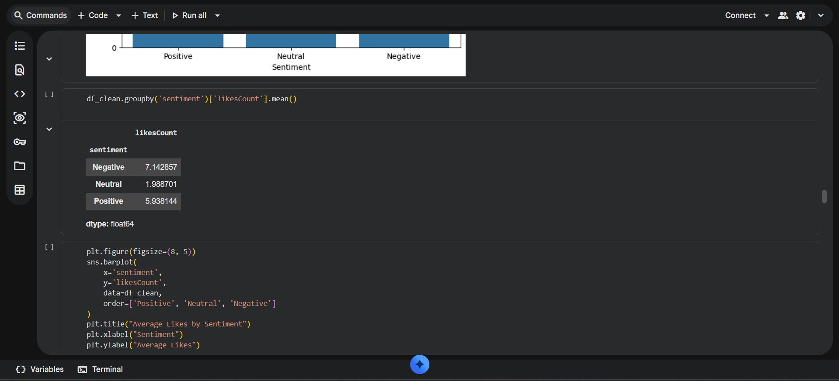

Slide 17
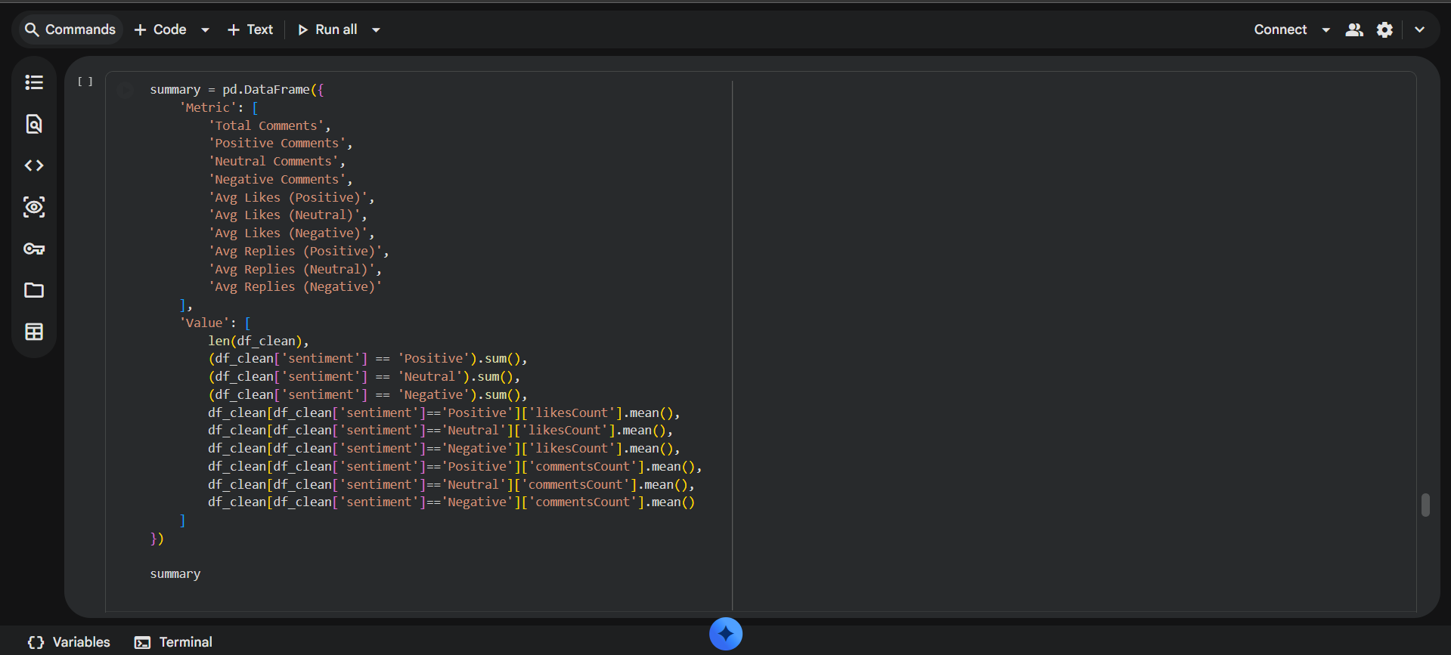
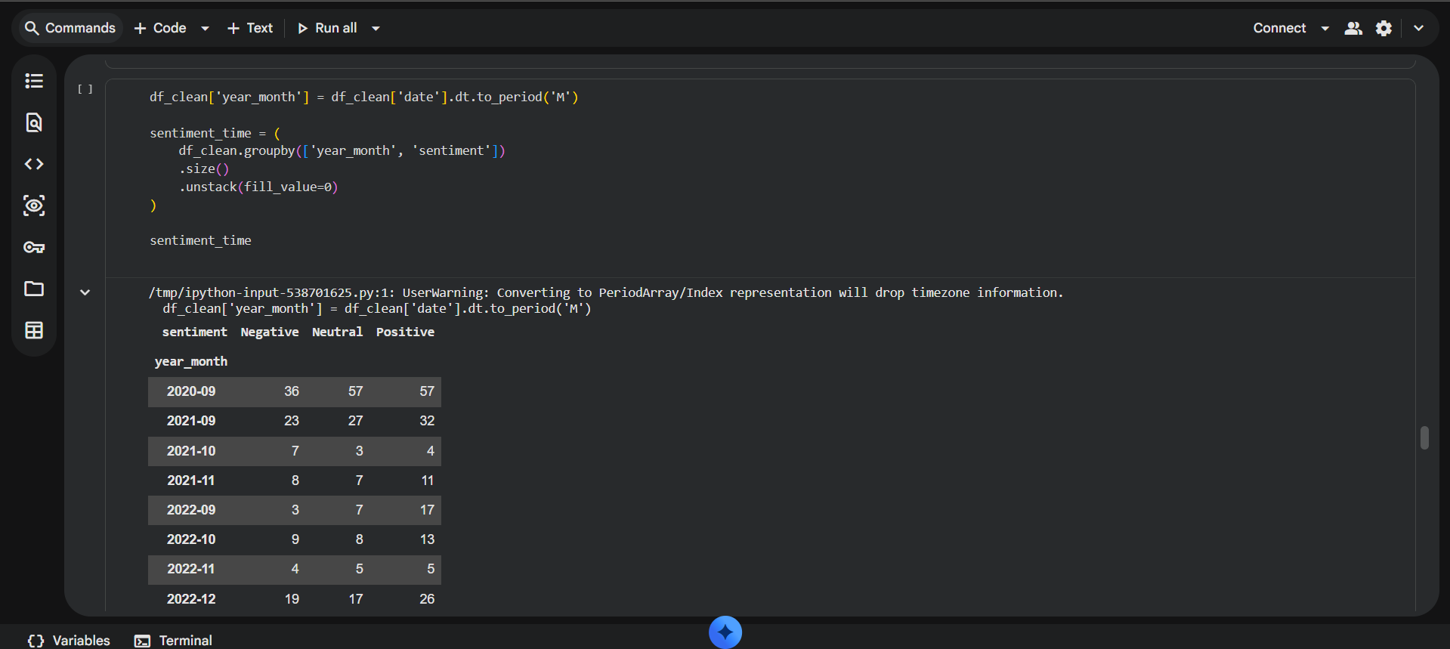

Slide 18
